Slide 1
Literary Analysis
Text Dependent Analysis Essay
on Frank Stockton’s
“The Lady or the Tiger?”

Slide 2
TDA – Text Dependent Analysis
Answer the TDA Prompt in essay form. Be sure to explain the concept or idea from the literary work or works through multiple lenses/literary devices. You need to ‘dissect’ the prompt.
Five paragraphs with an introduction, 3 body paragraphs, and a conclusion.

Slide 3
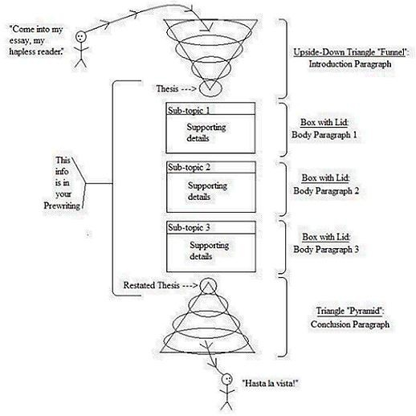
Formal Essay Structure

Slide 4
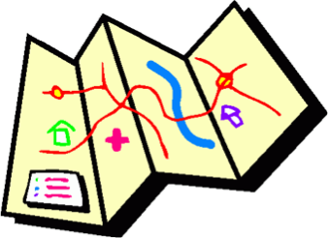
The Claim
States in ONE SENTENCE the specific point of the essay’s topic and answers the prompt.
The road map of the essay—it guides the content and organization of the three body paragraphs.
Unifies the essay with key words and phrases.
Belongs at the end of the introduction (last sentence of intro.)

Slide 5
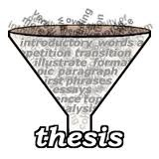
The Introduction
Called a funnel introduction.
Moves from the general to the specific.
Always include the title, the author and the genre of the literary work/s in the introduction.
Conclude with the most specific information: the claim statement.

Slide 6
Writing the Intro
Hook/Lead- should be a general statement about a theme or central idea in the text.
Mention the author, text, and connect it theme/central idea.
Link the text to the prompt.
End with claim statement.

Slide 7
Model
Courage means different things to different people. In the classic, young adult novel, The Outsiders, S. E. Hinton shows that even greasers can perform heroic acts of courage. Johnny Cade may appear to be the lost puppy everyone must watch after, but he emerges from that victim stereotype. Johnny is the most courageous of the greasers because of his ability to endure hardships, put others before himself, and face death gallantly.

Slide 8
Model
Courage means different things to different people. In the classic, young adult novel, The Outsiders, S. E. Hinton shows that even greasers can perform heroic acts of courage. Johnny Cade may appear to be the lost puppy everyone must watch after, but he emerges from that victim stereotype. Johnny is the most courageous of the greasers because of his ability to endure hardships, put others before himself, and face death gallantly.

Slide 9
Body Paragraphs
Claim: Johnny is the most courageous of the greasers because of his ability to endure hardships, put others before himself, and face death gallantly.
Body # 1 – His ability to endure hardships
Body #2 – His ability to put others before himself
Body # 3 – His ability to face death gallantly

