Slide 1
What is an ode?

Slide 2
An ode is a poem in which a person expresses a strong feeling of love or respect for something. It is a lyrical poem with varying line length and a varying number of stanzas. It comes from the word chant, so it often has repetition and sounds like it is meant to be sung.
ODE

Slide 3
Use these guidelines when working on your odes

Slide 4
Pick an ordinary place or thing.
Something you really like, love, adore, can’t live without…

Slide 5
GIVE YOUR SUBJECT PRAISE OR THANKS.

Slide 6
SPEAK DIRECTLY TO THE OBJECT.
(Oh, _____________!)

Slide 7
USE adjectives to describe it.

Slide 8
Use verbs to bring that object to life. (Personification)

Slide 9
Use at least 2 different senses

Slide 10
Use repeated lines.

Slide 11
Use 16-20 lines (one, two or FOUR stanzas).

Slide 12
Illustrate your ode.

Slide 13
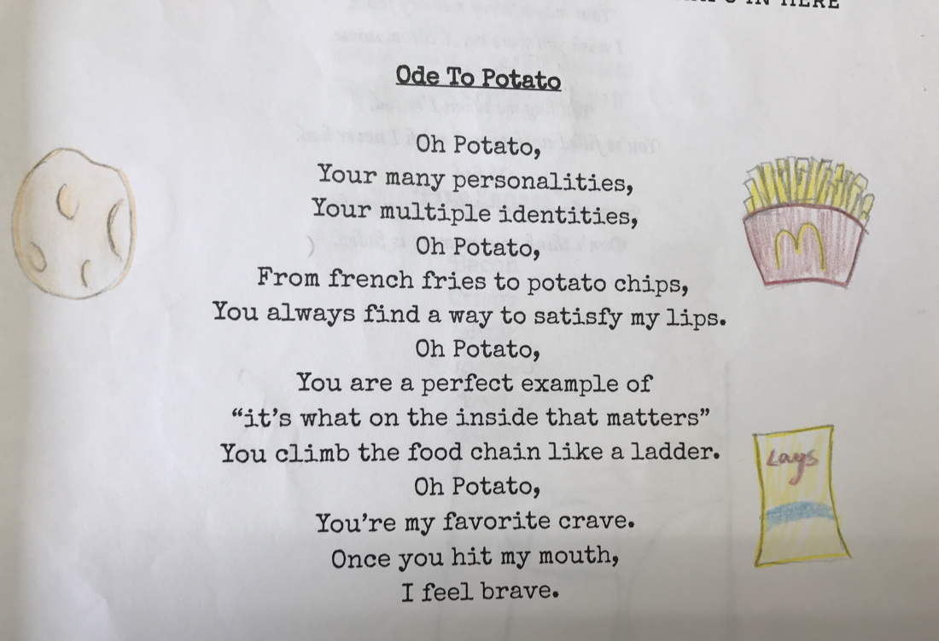

Slide 14
