Slide 1
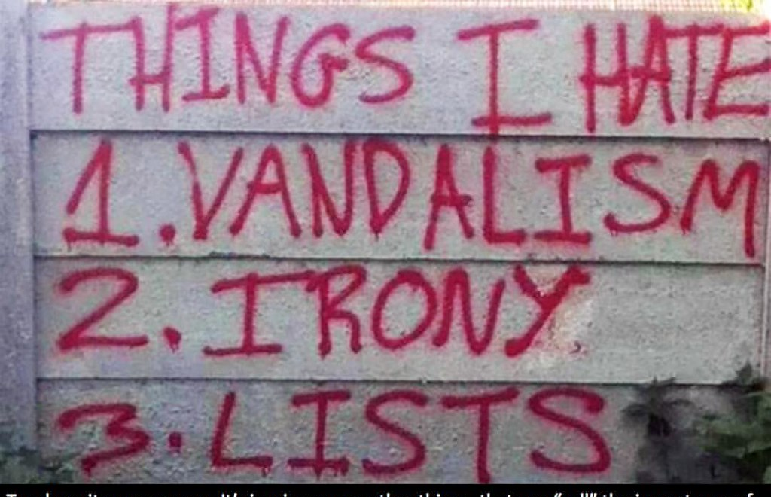
Irony
Objectives:
Students will be able to define irony.
Students will be able to identify the three types of irony.

Slide 2
Review of definition
Irony is the opposite of what is expected.
It’s the contradiction between what happens and what you expected to happen.

Slide 3
Purpose of Irony
It is often used to add suspense and interest. It can even add humor.
It is also used to keep the reader thinking about the theme of the story.
It also helps the reader make connections. Things don’t always turn out in life the way we expect them to……..

Slide 4
Types of Irony
Irony
Verbal
Irony
Situational
Irony
Dramatic
Irony

Slide 5
Verbal Irony
You use it everyday when you say one thing but really mean the opposite.
It has a tone of sarcasm to it.

Slide 6
Verbal Irony Examples
The locker room smells really good.
Awesome! Another TDA essay!
As your teacher says in an irritated voice, “I just love when students miss a day of school and ask, ‘did I miss anything important?’
Smart thinking, Einstein.
The town on Summit being FLAT!

Slide 8
Video Clip
https://www.youtube.com/watch?v=IiR-bnCHIYo

Slide 9
Situational Irony
Occurs when a situation turns out to be the opposite of what you thought it would be.
(When we say something is ironic, we mean it’s situationally ironic.)

Slide 10
Examples of Situational Irony
The firehouse burns down.
The chef won’t eat their own cooking.
The barber always needs a hair cut himself.
Bill Gates uses an Apple computer.
The kidnappers pay the ransom to give the kid back.

Slide 12
Video Clip
https://www.youtube.com/watch?v=tqg6RO8c_W0

Slide 13
Dramatic Irony
When the reader understands more about the events of a story than a character does.
This is used to engage the audience and keep them actively involved in the storyline.
It is used to create suspense as the reader reads on to find out what happens when/if the characters learns what he/she already knows.

Slide 14
Examples of Dramatic Irony
Tim’s parents are proud of the “A” he got on the test, but we know he cheated.
Alex writes a love poem to Judy but we know that Judy loves Devin.
The reader knows that Della sold her hair to buy Jim a fob chain for his watch, but Jim doesn’t know why she cut her hair.

Slide 16
Video clip
https://www.youtube.com/watch?v=RZFYuX84n1U

Slide 17
CHECK THESE OUT!

Slide 18
An escalator leading to a fitness center.

Slide 23
Review
Something that is ironic is unexpected.
If unexpected by a character, it’s dramatic.
If unexpected by everyone, it’s situational.
If it’s sarcasm, it’s verbal.

Slide 24
Your responsibilities before our next class Teams meeting:
Research the meaning of the title “Lamb to the Slaughter” before our next class meeting. How is this title both an allusion AND an idiom? How does it apply in this story? This will be our discussion topic next week.
Review these two literary terms that we have discussed this year.
- Allusion: A reference to another work of literature, the Bible, a
famous person, a historical time period/event, etc.
- Idiom: A commonly used figurative expression (“Driving me up the
wall,” “Hit the roof,” and “Raining cats and dogs.”
3. Read “Lamb to the Slaughter” on www.commonlit.org. Remember we said Dahl is known for his DARK humor, so be prepared to be creeped out!
Also on CommonLit, after you finish reading the story, answer the
multiple-choice questions and write a thoughtful response to each of the
two TDA open-ended questions (8 and 9).
Complete the irony chart worksheet & submit in Canvas.
WATCH Alfred Hitchcock Presents “Lamb to the Slaughter.” https://www.schooltube.com/media/1_v65xhi8f . You’re
going to love it…it’s so creepy—especially at the end.
7. Submit the title of your free reading book in Canvas.
8. Continue writing in your Personal History/Journal. (no submission)
6.

