Slide 1
Nonfiction- Persuasive Texts

Slide 2
Fact and Opinion
https://www.youtube.com/watch?v=1Ngkj2Lx-Ks
Opinion pieces-
Pro Vs Con OR Persuasive/Argumentative
https://www.youtube.com/watch?v=YG1FfC8vpeY

Slide 3
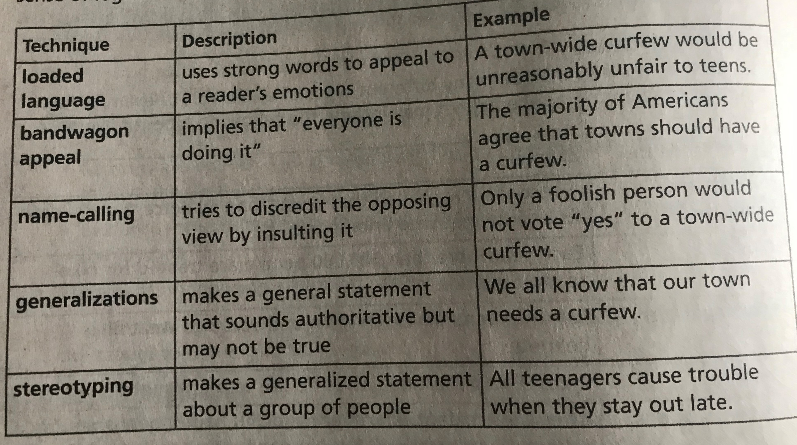
Persuasive Techniques
Authors use different persuasive techniques to draw a response from the reader. These techniques appeal to the reader’s emotions or sense of logic.

