Slide 1
Effective Elements of public speaking
“PVLEGS”

Slide 2
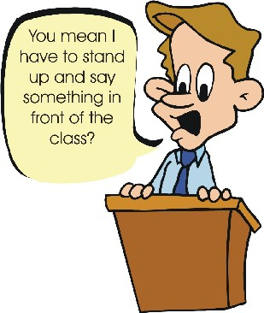
Poise
Voice
Life
Eye Contact
Gestures
Speed

Slide 3
Poise
Appear calm and confident
Avoid distracting behaviors

Slide 4
Voice
Speak every word clearly
Use a “just right” voice

Slide 5
life
Express passion and emotions in your voice

Slide 6
Eye Contact
Connect visually with the audience
Look towards each audience member

Slide 7
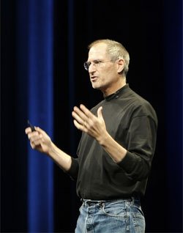
Gestures
Use appropriate hand movements
Move your body (don’t be stiff)
Have an expressive face

Slide 8
Speed
Talk with appropriate speed
Use pauses for effect and emphasis

